Slide 1
Artificial intelligence:
Informed Search
Original Slides by: Tom Lenaerts
Institut de Recherches Interdisciplinaires et de Développements en Intelligence Artificielle (IRIDIA)
Université Libre de Bruxelles
Adapted for Edinburgh Napier University by Christopher Stone
Notes:
1

Slide 2
Outline
Informed = use problem-specific knowledge
Which search strategies?
  Best-first search and its variants
Heuristic functions?
  A*
  How to invent them
Local search and optimization
January 30, 2017
Original Slides by Tom Lenaerts – IRIDIA ULB
Adapted for Edinburgh Napier by C. Stone
2
Notes:
2

Slide 3
Previously: tree-search
function TREE-SEARCH(problem,fringe) return a solution or failure
fringe ← INSERT(MAKE-NODE(INITIAL-STATE[problem]), fringe)
loop do
if EMPTY?(fringe) then return failure
node ← REMOVE-FIRST(fringe)
if GOAL-TEST[problem] applied to STATE[node] succeeds
then return SOLUTION(node)
fringe ← INSERT-ALL(EXPAND(node, problem), fringe)
A strategy is defined by picking the order of node expansion
January 30, 2017
Original Slides by Tom Lenaerts – IRIDIA ULB Adapted for Edinburgh Napier by C. Stone
3

Slide 4
Best-first search
General approach of informed search:
  Best-first search: node is selected for expansion based on an evaluation function f(n)
Idea: evaluation function measures distance to the goal.
  Choose node which appears best
Implementation:
  fringe is queue sorted in decreasing order of desirability.
  Special cases: greedy search, A* search
January 30, 2017
Original Slides by Tom Lenaerts – IRIDIA ULB Adapted for Edinburgh Napier by C. Stone
4

Slide 5
A heuristic function
[dictionary]“A rule of thumb, simplification, or educated guess that reduces or limits the search for solutions in domains that are difficult and poorly understood.”
  h(n) = estimated cost of the cheapest path from node n to goal node.
  If n is goal then h(n)=0
  More information later.
January 30, 2017
Original Slides by Tom Lenaerts – IRIDIA ULB Adapted for Edinburgh Napier by C. Stone
5

Slide 6
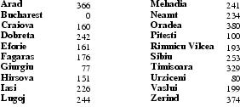
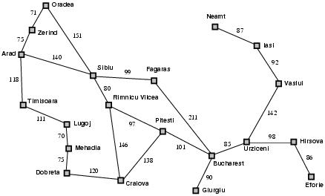
Romania with step costs in km
h_{SLD}=straight-line distance heuristic.
h_{SLD} can NOT be computed from the problem description itself
In this example f(n)=h(n)
  Expand node that is closest to goal
  = Greedy best-first search

Slide 7
Greedy search example
Arad (366)
Assume that we want to use greedy search to solve the problem of travelling from Arad to Bucharest.
The initial state=Arad

Slide 8
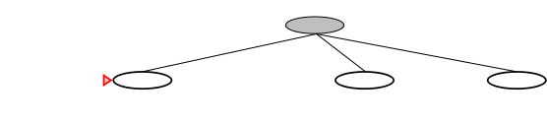
Greedy search example
Arad
Zerind(374)
Sibiu(253)
Timisoara
(329)
The first expansion step produces:
  Sibiu, Timisoara and Zerind
Greedy best-first will select Sibiu.

Slide 9
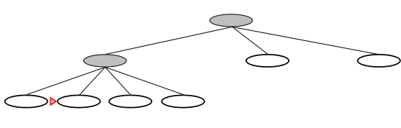
Greedy search example
Arad
Sibiu
Arad
(366)
Rimnicu Vilcea
(193)
Fagaras
(176)
Oradea
(380)
If Sibiu is expanded we get:
  Arad, Fagaras, Oradea and Rimnicu Vilcea
Greedy best-first search will select: Fagaras

Slide 10
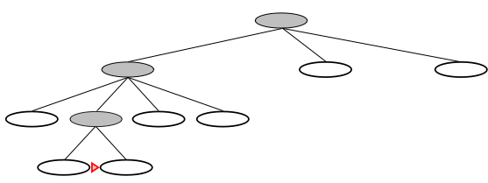
Greedy search example
Arad
Sibiu
Fagaras
Sibiu
(253)
Bucharest
(0)
If Fagaras is expanded we get:
  Sibiu and Bucharest
Goal reached !!
  Yet not optimal (see Arad, Sibiu, Rimnicu Vilcea, Pitesti)

Slide 11
A* search
Best-known form of best-first search.
Idea: avoid expanding paths that are already expensive.
Evaluation function f(n)=g(n) + h(n)
  g(n) the cost (so far) to reach the node.
  h(n) estimated cost to get from the node to the goal.
  f(n) estimated total cost of path through n to goal.

Slide 12
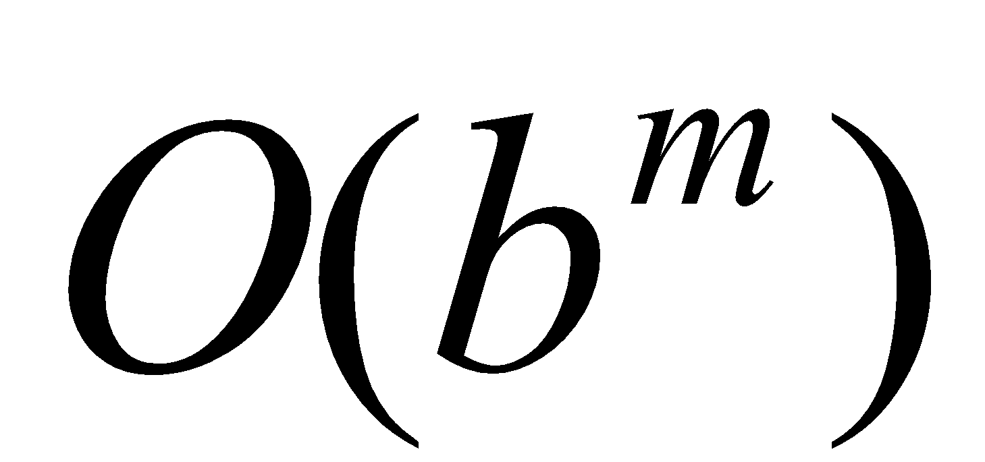
Greedy search, evaluation
Completeness: NO (cfr. DF-search)
Time complexity?
  Cfr. Worst-case DF-search
  (with m is maximum depth of search space)
  Good heuristic can give dramatic improvement.
January 30, 2017
Original Slides by Tom Lenaerts – IRIDIA ULB Adapted for Edinburgh Napier by C. Stone
12

Slide 13
Greedy search, evaluation
Completeness: NO (cfr. DF-search)
Time complexity:
Space complexity:
  Keeps all nodes in memory
January 30, 2017
Original Slides by Tom Lenaerts – IRIDIA ULB Adapted for Edinburgh Napier by C. Stone
13

Slide 14
Greedy search, evaluation
Completeness: NO (cfr. DF-search)
Time complexity:
Space complexity:
Optimality? NO
  Same as DF-search
January 30, 2017
Original Slides by Tom Lenaerts – IRIDIA ULB Adapted for Edinburgh Napier by C. Stone
14

Slide 15
Pathfinding
Many problems yet to be solved
Edinburgh-Sweden
Edinburgh-Romania
Edinburgh-France
Pathfinding methods are applicable to abstract problems
January 30, 2017
Original Slides by Tom Lenaerts – IRIDIA ULB Adapted for Edinburgh Napier by C. Stone
15

Slide 16
A* search
Best-known form of best-first search.
Idea: avoid expanding paths that are more expensive.
Evaluation function f(n)=g(n) + h(n)
  g(n) the cost (so far) to reach the node.
  h(n) estimated cost to get from the node to the goal.
  f(n) estimated total cost of path through n to goal.
January 30, 2017
Original Slides by Tom Lenaerts – IRIDIA ULB Adapted for Edinburgh Napier by C. Stone
16

Slide 17
A* search
A* search uses an admissible heuristic
  A heuristic is admissible if it never overestimates the cost to reach the goal
  Are optimistic
    Formally:
    1. h(n) <= h*(n) where h*(n) is the true cost from n
    2. h(n) >= 0 so h(G)=0 for any goal G.
    e.g. h_{SLD}(n) never overestimates the actual road distance
January 30, 2017
Original Slides by Tom Lenaerts – IRIDIA ULB Adapted for Edinburgh Napier by C. Stone
17

Slide 18
Romania example

Slide 19
A* search example
Find Bucharest starting at Arad
  f(Arad) = c(??,Arad)+h(Arad)=0+366=366

Slide 20

A* search example
Expand Arrad and determine f(n) for each node
  f(Sibiu)=c(Arad,Sibiu)+h(Sibiu)=140+253=393
  f(Timisoara)=c(Arad,Timisoara)+h(Timisoara)=118+329=447
  f(Zerind)=c(Arad,Zerind)+h(Zerind)=75+374=449
Best choice is Sibiu

Slide 21
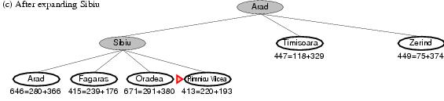
A* search example
Expand Sibiu and determine f(n) for each node
  f(Arad)=c(Sibiu,Arad)+h(Arad)=280+366=646
  f(Fagaras)=c(Sibiu,Fagaras)+h(Fagaras)=239+179=415
  f(Oradea)=c(Sibiu,Oradea)+h(Oradea)=291+380=671
  f(Rimnicu Vilcea)=c(Sibiu,Rimnicu Vilcea)+
  h(Rimnicu Vilcea)=220+192=413
Best choice is Rimnicu Vilcea

Slide 22
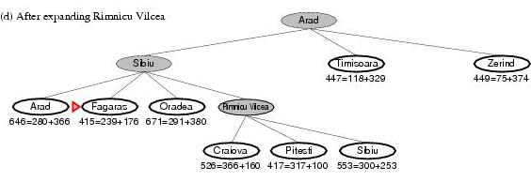
A* search example
Expand Rimnicu Vilcea and determine f(n) for each node
  f(Craiova)=c(Rimnicu Vilcea, Craiova)+h(Craiova)=360+160=526
  f(Pitesti)=c(Rimnicu Vilcea, Pitesti)+h(Pitesti)=317+100=417
  f(Sibiu)=c(Rimnicu Vilcea,Sibiu)+h(Sibiu)=300+253=553
Best choice is Fagaras

Slide 23
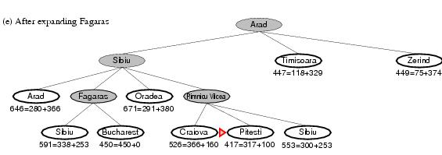
A* search example
Expand Fagaras and determine f(n) for each node
  f(Sibiu)=c(Fagaras, Sibiu)+h(Sibiu)=338+253=591
  f(Bucharest)=c(Fagaras,Bucharest)+h(Bucharest)=450+0=450
Best choice is Pitesti !!!

Slide 24
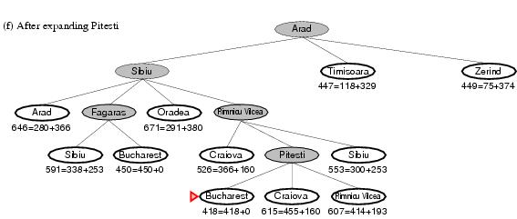
A* search example
Expand Pitesti and determine f(n) for each node
  f(Bucharest)=c(Pitesti,Bucharest)+h(Bucharest)=418+0=418
Best choice is Bucharest !!!
  Optimal solution (only if h(n) is admissable)
Note values along optimal path !!

Slide 25
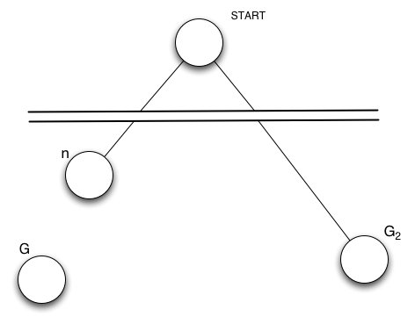
Optimality of A*(standard proof)
Suppose suboptimal goal G₂ in the queue.
Let n be an unexpanded node on a shortest to optimal goal G.
    f(G₂ ) = g(G₂ ) since h(G₂ )=0
    > g(G) since G₂ is suboptimal
    >= f(n) since h is admissible
    Since f(G₂) > f(n), A* will never select G₂ for expansion

Slide 26
BUT … graph search
Discards new paths to repeated state.
  Previous proof breaks down
Solution:
  Add extra bookkeeping i.e. remove more expensive of two paths.
  Ensure that optimal path to any repeated state is always first followed.
    Extra requirement on h(n): consistency (monotonicity)
January 30, 2017
Original Slides by Tom Lenaerts – IRIDIA ULB Adapted for Edinburgh Napier by C. Stone
26

Slide 27
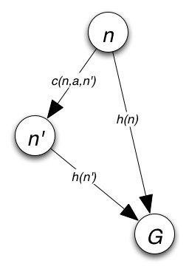
Consistency
A heuristic is consistent if
If h is consistent, we have
i.e. f(n) is nondecreasing along any path.

Slide 28
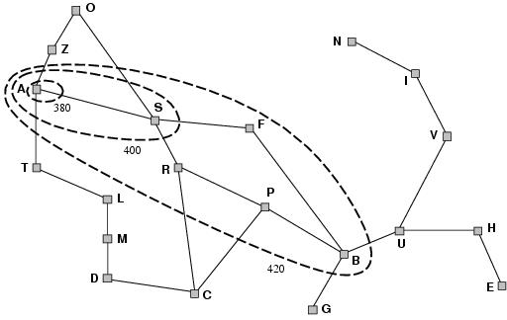
Optimality of A*(more usefull)
A* expands nodes in order of increasing f value
Contours can be drawn in state space
  Uniform-cost search adds circles.
  F-contours are gradually
  Added:
  1) nodes with f(n)<C*
  2) Some nodes on the goal
  Contour (f(n)=C*).
  Contour I has all
  Nodes with f=f_{i}, where
  f_{i} < f_{i}+1.

Slide 29
A* search, evaluation
Completeness: YES
  Since bands of increasing f are added
  Unless there are infinitly many nodes with f<f(G)
January 30, 2017
Original Slides by Tom Lenaerts – IRIDIA ULB Adapted for Edinburgh Napier by C. Stone
29

Slide 30
A* search, evaluation
Completeness: YES
Time complexity:
  Number of nodes expanded is still exponential in the length of the solution.
January 30, 2017
Original Slides by Tom Lenaerts – IRIDIA ULB Adapted for Edinburgh Napier by C. Stone
30

Slide 31
A* search, evaluation
Completeness: YES
Time complexity: (exponential with path length)
Space complexity:
  It keeps all generated nodes in memory
  Hence space is the major problem not time
January 30, 2017
Original Slides by Tom Lenaerts – IRIDIA ULB Adapted for Edinburgh Napier by C. Stone
31

Slide 32
A* search, evaluation
Completeness: YES
Time complexity: (exponential with path length)
Space complexity:(all nodes are stored)
Optimality: YES
  Cannot expand f_{i+1} until f_{i} is finished.
  A* expands all nodes with f(n)< C*
  A* expands some nodes with f(n)=C*
  A* expands no nodes with f(n)>C*
Also optimally efficient (not including ties)
January 30, 2017
Original Slides by Tom Lenaerts – IRIDIA ULB Adapted for Edinburgh Napier by C. Stone
32

Slide 33
A* search
Ingredients :
  OpenList (frontier)
  ClosedList (examined nodes)
  ParentMap
  CurrentNode
  fScore Map (collection of all f(n))
  gScore Map (distances from start to nodes)
January 30, 2017
Original Slides by Tom Lenaerts – IRIDIA ULB Adapted for Edinburgh Napier by C. Stone
33

Slide 34
Add starting node to OpenList
While OpenList NOT empty
CurrentNode := lowest scoring node in OpenList
If current = goal
Return build_path(parentMap,currentNode)
OpenList.Remove (Current Node)
ClosedSet.Add(Current Node)
For each neighbour of Current Node
If ClosedList contains neighbour
Continue
Neighbour_score := ScoreMap[CurrentNode] + distance(CurrentNode, neighbour)
If OpenList NOT contains neighbour
Openlist.Add(neighbour)
ParentMap[neighbour] := current Node
gScoreMap[neighbour] := Neighbour_score
fScoreMap[neighbour] := gScoreMap[neighbour] + heuristic_dist(neighbour,goal)
Return failure
January 30, 2017
Original Slides by Tom Lenaerts – IRIDIA ULB Adapted for Edinburgh Napier by C. Stone
34

Slide 35
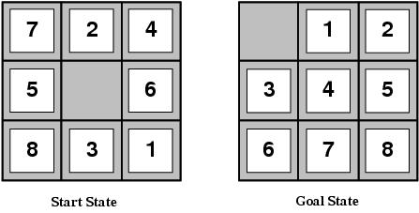
Heuristic functions
E.g for the 8-puzzle
  Avg. solution cost is about 22 steps (branching factor +/- 3)
  Exhaustive search to depth 22: 3.1 x 10¹⁰ states.
  A good heuristic function can reduce the search process.

Slide 36
Heuristic functions
E.g for the 8-puzzle knows two commonly used heuristics
h₁ = the number of misplaced tiles
  h₁(s)=8
h₂ = the sum of the distances of the tiles from their goal positions (manhattan distance).
  h₂(s)=3+1+2+2+2+3+3+2=18

Slide 37
Heuristic quality
Effective branching factor b*
  Is the branching factor that a uniform tree of depth d would have in order to contain N+1 nodes.
  Measure is fairly constant for sufficiently hard problems.
    Can thus provide a good guide to the heuristic’s overall usefulness.
    A good value of b* is 1.
January 30, 2017
Original Slides by Tom Lenaerts – IRIDIA ULB Adapted for Edinburgh Napier by C. Stone
37

Slide 38
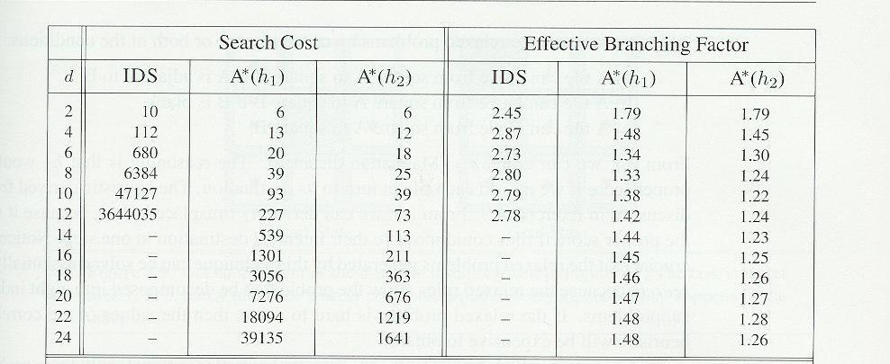
Heuristic quality and dominance
1200 random problems with solution lengths from 2 to 24.
If h₂(n) >= h₁(n) for all n (both admissible)
then h₂ dominates h₁ and is better for search

Slide 39
Inventing admissible heuristics
Admissible heuristics can be derived from the exact solution cost of a relaxed version of the problem:
  Relaxed 8-puzzle for h₁ : a tile can move anywhere
    As a result, h₁(n) gives the shortest solution
  Relaxed 8-puzzle for h₂ : a tile can move to any adjacent square.
    As a result, h₂(n) gives the shortest solution.
The optimal solution cost of a relaxed problem is no greater than the optimal solution cost of the real problem.
ABSolver found a usefull heuristic for the rubic cube.
January 30, 2017
Original Slides by Tom Lenaerts – IRIDIA ULB Adapted for Edinburgh Napier by C. Stone
39

Slide 40
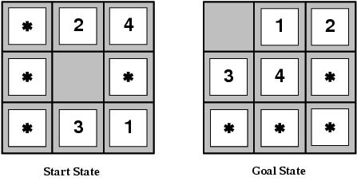
Inventing admissible heuristics
Admissible heuristics can also be derived from the solution cost of a subproblem of a given problem.
This cost is a lower bound on the cost of the real problem.
Pattern databases store the exact solution to for every possible subproblem instance.
  The complete heuristic is constructed using the patterns in the DB

Slide 41
Inventing admissible heuristics
Another way to find an admissible heuristic is through learning from experience:
  Experience = solving lots of 8-puzzles
  An inductive learning algorithm can be used to predict costs for other states that arise during search.
January 30, 2017
Original Slides by Tom Lenaerts – IRIDIA ULB Adapted for Edinburgh Napier by C. Stone
41

Slide 42
Local search and optimization
Local search= use single current state and move to neighboring states.
Advantages:
  Use very little memory
  Find often reasonable solutions in large or infinite state spaces.
Are also useful for pure optimization problems.
  Find best state according to some objective function.
  e.g. survival of the fittest as a metaphor for optimization.

Slide 43
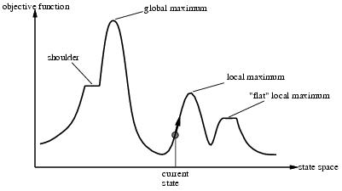
Local search and optimization

Slide 44
Hill-climbing search
“is a loop that continuously moves in the direction of increasing value”
  It terminates when a peak is reached.
Hill climbing does not look ahead of the immediate neighbors of the current state.
Hill-climbing chooses randomly among the set of best successors, if there is more than one.
Hill-climbing a.k.a. greedy local search
January 30, 2017
Original Slides by Tom Lenaerts – IRIDIA ULB Adapted for Edinburgh Napier by C. Stone
44

Slide 45
Hill-climbing search
function HILL-CLIMBING( problem) return a state that is a local maximum
input: problem, a problem
local variables: current, a node.
neighbor, a node.
current ← MAKE-NODE(INITIAL-STATE[problem])
loop do
neighbor ← a highest valued successor of current
if VALUE [neighbor] ≤ VALUE[current] then return STATE[current]
current ← neighbor
January 30, 2017
Original Slides by Tom Lenaerts – IRIDIA ULB Adapted for Edinburgh Napier by C. Stone
45

Slide 46
Hill-climbing example
8-queens problem (complete-state formulation).
Successor function: move a single queen to another square in the same column.
Heuristic function h(n): the number of pairs of queens that are attacking each other (directly or indirectly).
January 30, 2017
Original Slides by Tom Lenaerts – IRIDIA ULB Adapted for Edinburgh Napier by C. Stone
46

Slide 47
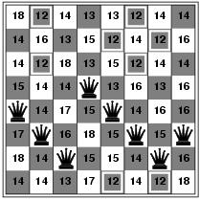
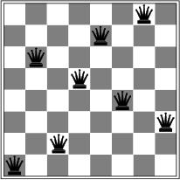
Hill-climbing example
a)
b)
a) shows a state of h=17 and the h-value for each possible successor.
b) A local minimum in the 8-queens state space (h=1).

Slide 48
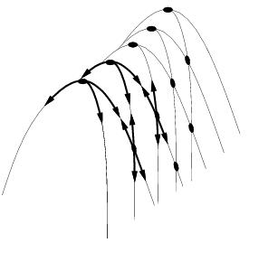
Drawbacks
Ridge = sequence of local maxima difficult for greedy algorithms to navigate
Plateaux = an area of the state space where the evaluation function is flat.
Gets stuck 86% of the time.

Slide 49
Hill-climbing variations
Stochastic hill-climbing
  Random selection among the uphill moves.
  The selection probability can vary with the steepness of the uphill move.
First-choice hill-climbing
  cfr. stochastic hill climbing by generating successors randomly until a better one is found.
Random-restart hill-climbing
  Tries to avoid getting stuck in local maxima.
January 30, 2017
Original Slides by Tom Lenaerts – IRIDIA ULB Adapted for Edinburgh Napier by C. Stone
49

Slide 50
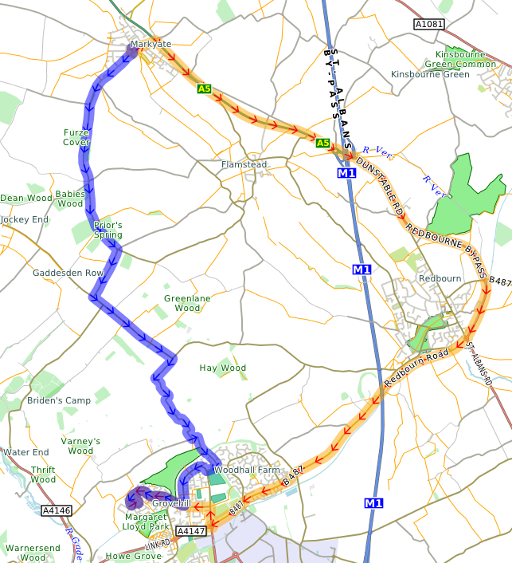
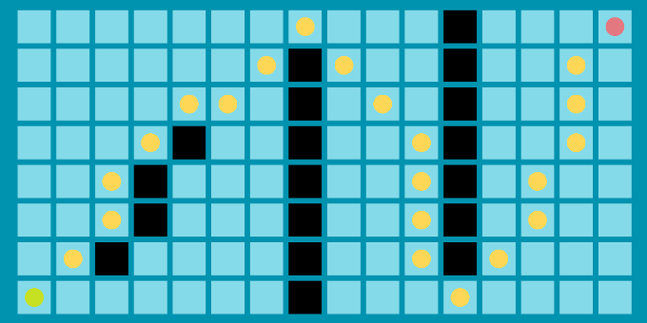
Pathfinding Applications
Place to Place
January 30, 2017
Original Slides by Tom Lenaerts – IRIDIA ULB Adapted for Edinburgh Napier by C. Stone
50

Slide 51
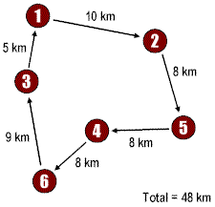
Pathfinding Applications
TSP
January 30, 2017
Original Slides by Tom Lenaerts – IRIDIA ULB Adapted for Edinburgh Napier by C. Stone
51

Slide 52

Pathfinding Applications
Person to person (social network)
January 30, 2017
Original Slides by Tom Lenaerts – IRIDIA ULB Adapted for Edinburgh Napier by C. Stone
52

Slide 53
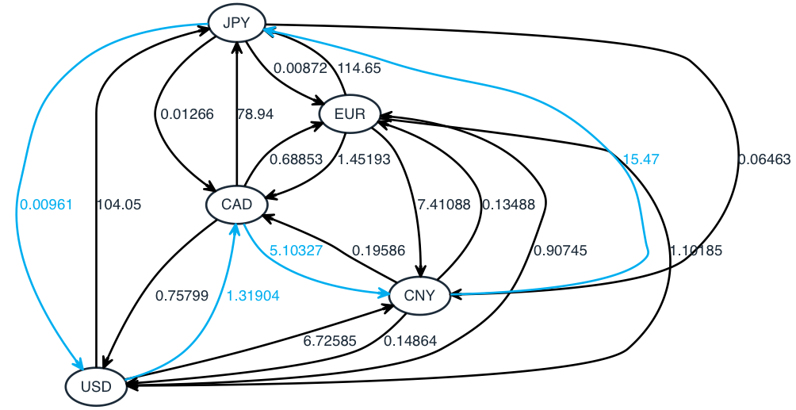
Pathfinding Applications
Currency to Currency. Arbitrage (finance)
January 30, 2017
Original Slides by Tom Lenaerts – IRIDIA ULB Adapted for Edinburgh Napier by C. Stone
53

Slide 54

Pathfinding Applications
Machine to Machine (data network)
January 30, 2017
Original Slides by Tom Lenaerts – IRIDIA ULB Adapted for Edinburgh Napier by C. Stone
54

